Slide 1


Cube Matrix Visualizing Indoor Data Bringing Your Environment to Life！
CASA0021: Connected Environments Group Prototype and Pitch 23/24
Satria Utama
Guandi Chen
Zekun Wang
Huanchao Hong
22nd January 2024

Slide 2
Outline
Project Overview
Product Features
Technical Implementation
Target Users and Usage Scenarios
Challenges
Future Development Plans

Slide 3
Project Rationale
Project Overview
Temperature and humidity play a role in influencing thermal comfort in indoor spaces ^{[1]}
CO2 level affect human’s productivity. ^{[2]}
Excessive level of Temperature, humidity and CO2 can bring negative impact to human health-being. ^{[2][3]}

Slide 4
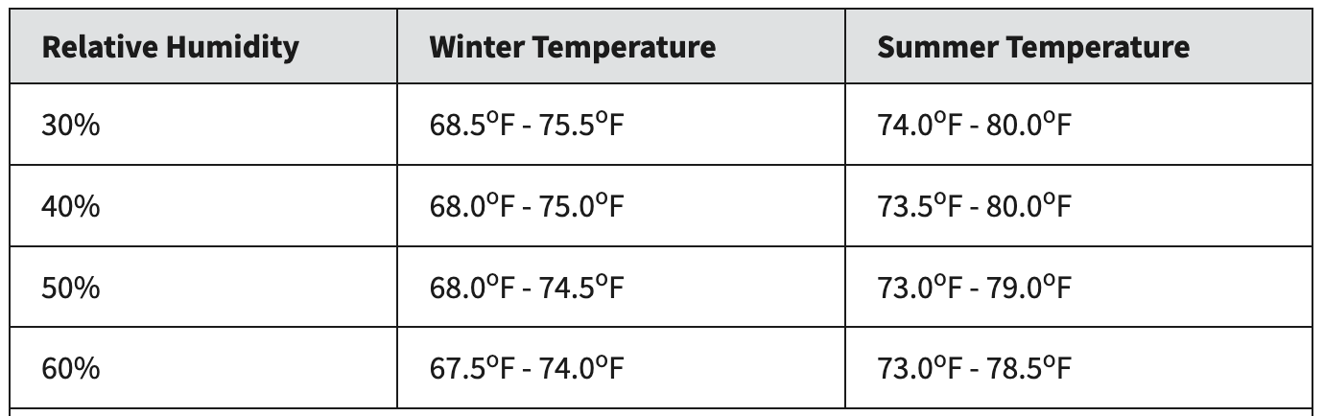
Ideal Value...
Project Overview
There is no such ideal or perfect temperature and humidity…
Recommended Temperature from CIBSE ^{[4]}
Recommended By | Recommended range | Intended Purpose (Indoor)
CIBSE Guide A | 17°C to 19°C | In winter, for bedrooms
CIBSE Guide A | 20°C to 22°C | In winter, for living rooms
CIBSE Guide A | 23°C to 26°C | In summer, for living rooms and bedroom
Recommended Temperature & Humidity from ASHRAE ​
（20°C - 24°C）
（23°C - 27°C）
（20°C - 24°C）
（23°C - 27°C）
（20°C - 24°C）
（23°C - 26°C）
（20°C - 23°C）
（23°C - 26°C）

Slide 5
Ideal Value... (cont)
Project Overview
Recommended CO2 level (ppm)
Recommended By | Recommended range | Intended Purpose
ASHRAE | < 400 ppm | Outdoor
 | 400 – 1000ppm | Occupied indoor spaces
 | 1,000 - 2,000ppm | Common complaints of drowsiness or poor air quality

Slide 6





Data Visualization
Project Overview
“Data visualization is the representation of data through use of common graphics, such as charts, plots, infographics, and even animations’’ – IBM
But using number and chart to display data can be boring…

Slide 7
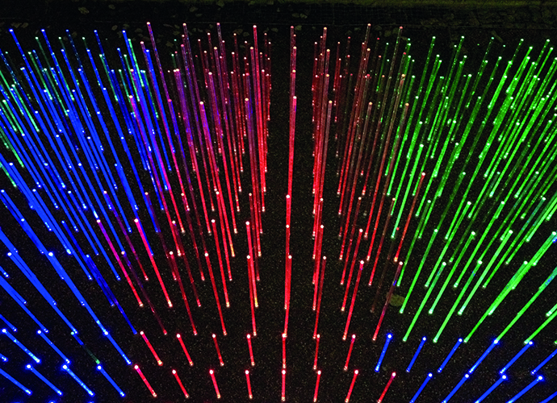
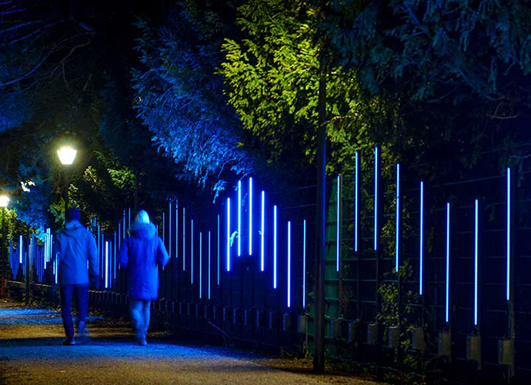
Data visualizations using light
Project Overview
Data visualizations using light installations involve translating data sets into visual displays using light as the primary medium.
We Could Meet by Martin Richman (UK), Crossrail Place, Level -1, Quayside
On the Wave of Light by Those Guys Lighting (Latvia), Riverside
Acrylic rod that regularly changes colour and frequency throughout the day and evening, mimicking the changing environment
An interactive art installation with 100 LED light sticks that respond to movement, creating a wave-like, lingering light effect.

Slide 8
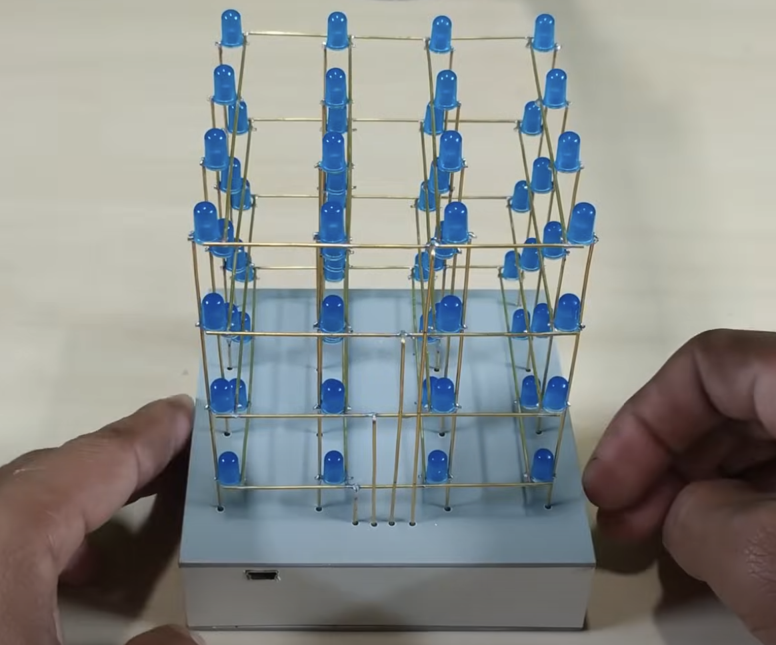



Cube Matrix RGB LED
Project Overview
By using RGB LED, we can play with :
Color
Brightness
Animation such as direction of wave
https://www.youtube.com/watch?v=JACwa8wgQVU

Slide 9

Questions
Project Overview
How can an RGB cube matrix be used to visualize multi-dimensional data (e.g., temperature, humidity, CO2) from sensors in an intuitive and interactive display? ​

Slide 10
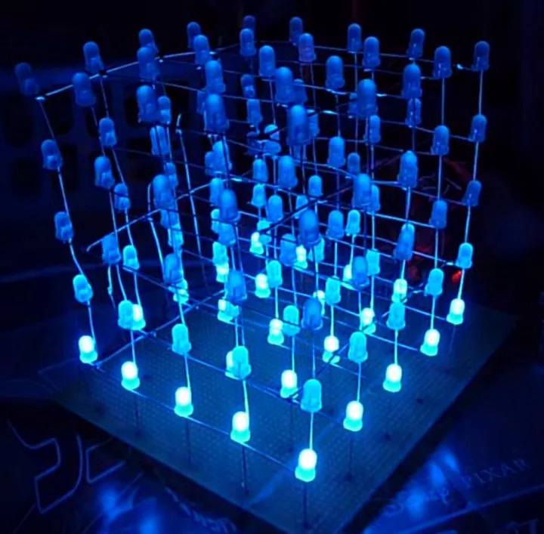
Product Features
Core Functions
Real-time Monitoring: Tracks indoor temperature, humidity, and CO2 levels.
Dynamic Display: Reflects data through LED colour, pulsation frequency, and dynamic patterns.
Data Visualization: Presents environmental status in an intuitive and easily understandable way through graphics and colour changes.
https://zhuanlan.zhihu.com/p/472479698

Slide 11
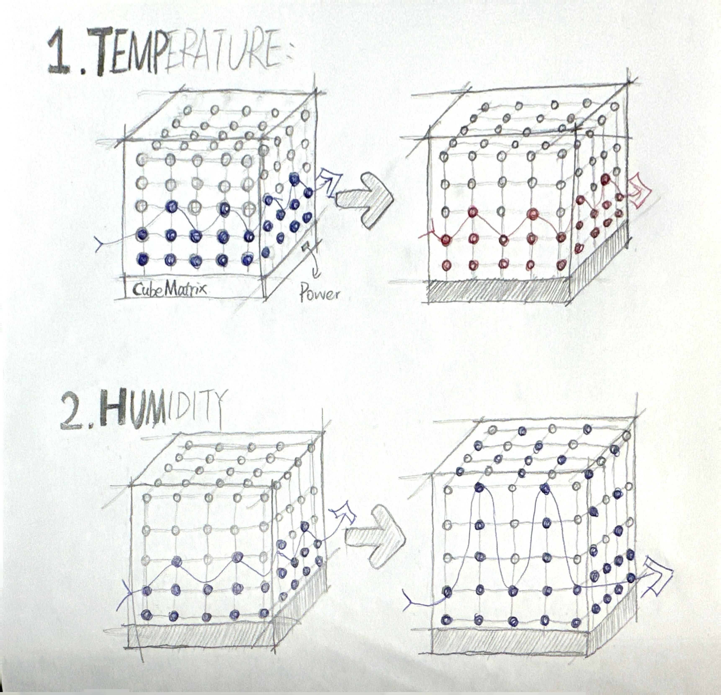
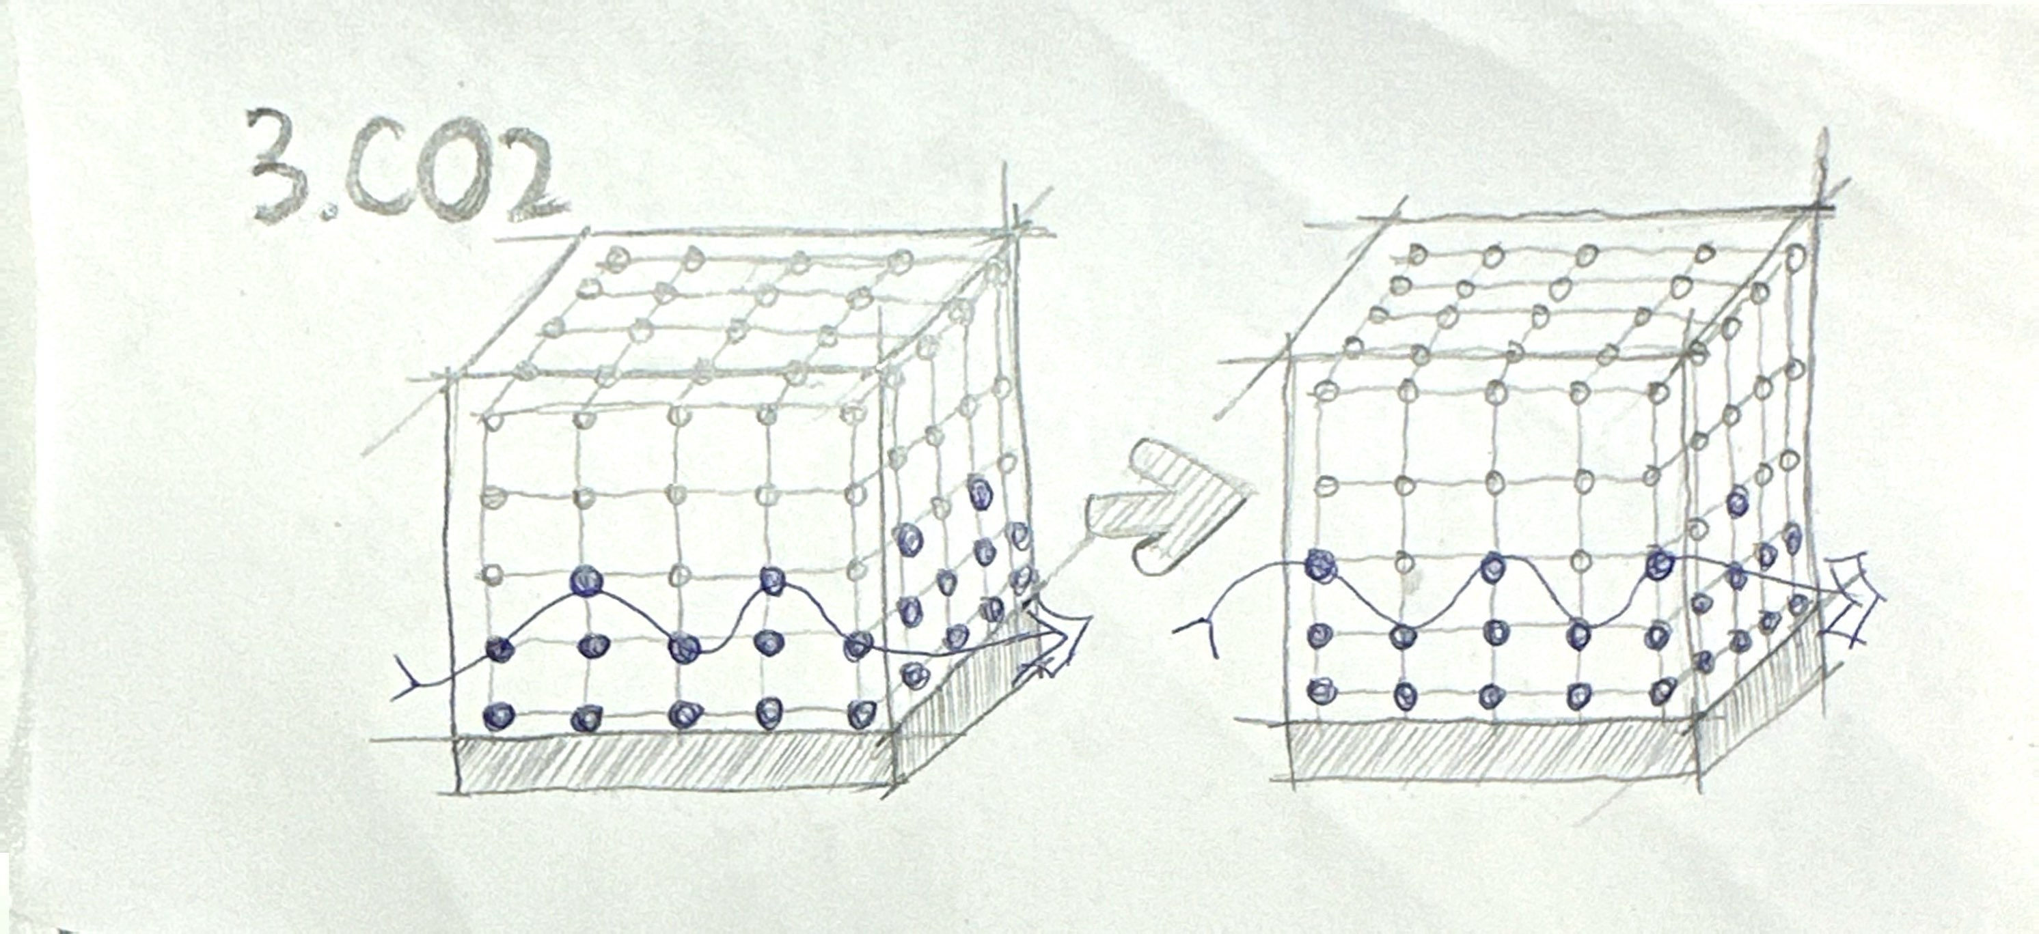
Product Features
Design Concept
1.Temperature- Colour
3.CO2 Level- Frequency
？
？
2.Humidity-Wave Height
once per second
twice per second or more
？
Faster wave motion
interesting

Slide 12
Technical Implementation
Hardware and Software Components
Control System
74HC595 shift register
An integrated circuit that converts serial input to parallel output.
Each IC provides 8 additional output pins.
Expand the I/O capabilities of Arduino to effectively control many LEDs.
Arduino Uno
Microcontroller board, based on ATmega328P.
Provides 14 digital I/O pins and 6 analog input pins.

Slide 13
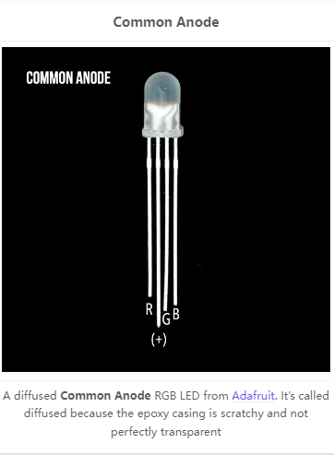
Technical Implementation
LEDs
The LEDs used in this cube are RGB LEDs with a common anode.
This LED needs to be adapted for further operation by bending the legs.
^{[5]}

Slide 14
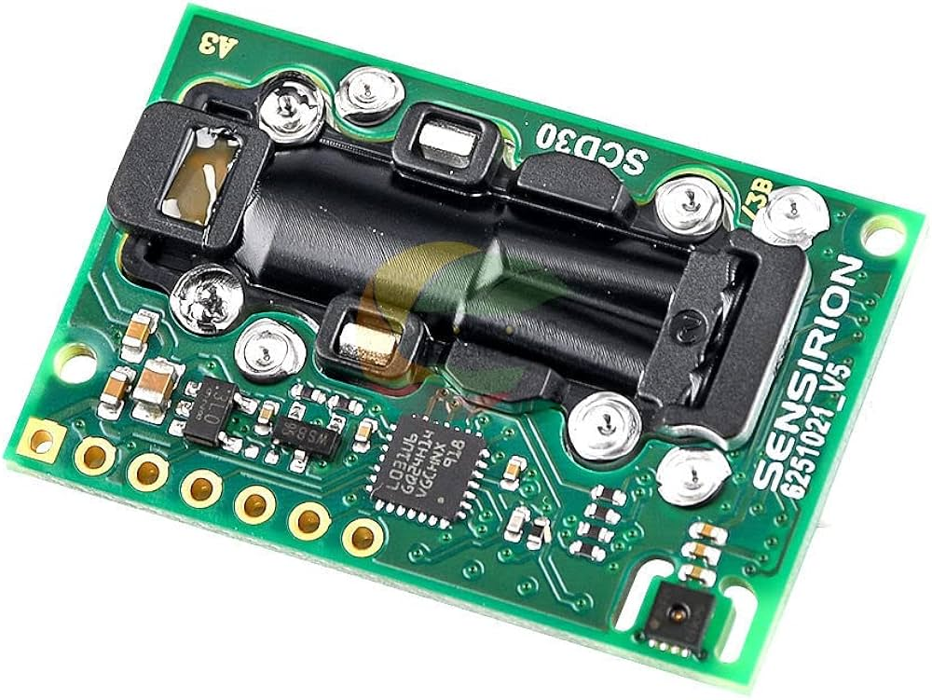
Technical Implementation
Power supply, Resistance and SCD30
LED Circuit Protection
LED Specs: Forward Voltage - 2V, Ideal Current - 20 mA
Arduino Uno Specs: Operating Voltage - 5V, I/O Pin Current - 20-40 mA, Total Board Current - Max 200 mA
Required Resistor: 150 Ω for circuit protection
SCD30
CO2, temperature and humidity.
Interfaces with Arduino via I²C communication.

Slide 15



Target Users and Usage Scenarios
Home Environment:
Placement: Living room or common areas
Function: Monitors temperature, humidity, CO2 levels
Importance: Critical for families with children or elderly
Additional Use: Acts as modern home decoration
Commercial Spaces:
Locations: Restaurants, coffee shops
Role: Visual centerpiece and environmental quality indicator
Interaction: Engages customers, enhances tech ambiance

Slide 16
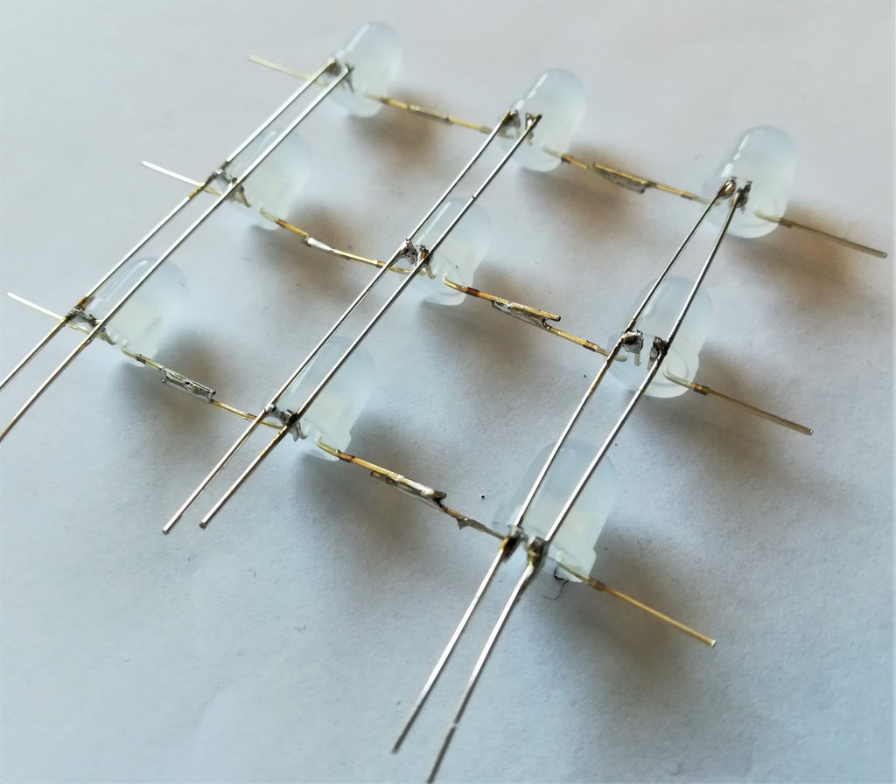
Challenges
Challenges we may face:
Hardware soldering​
PCB board design​
Hardware reliability​
Intuitive and easy-to-understand data visualization​
Coding

Slide 17
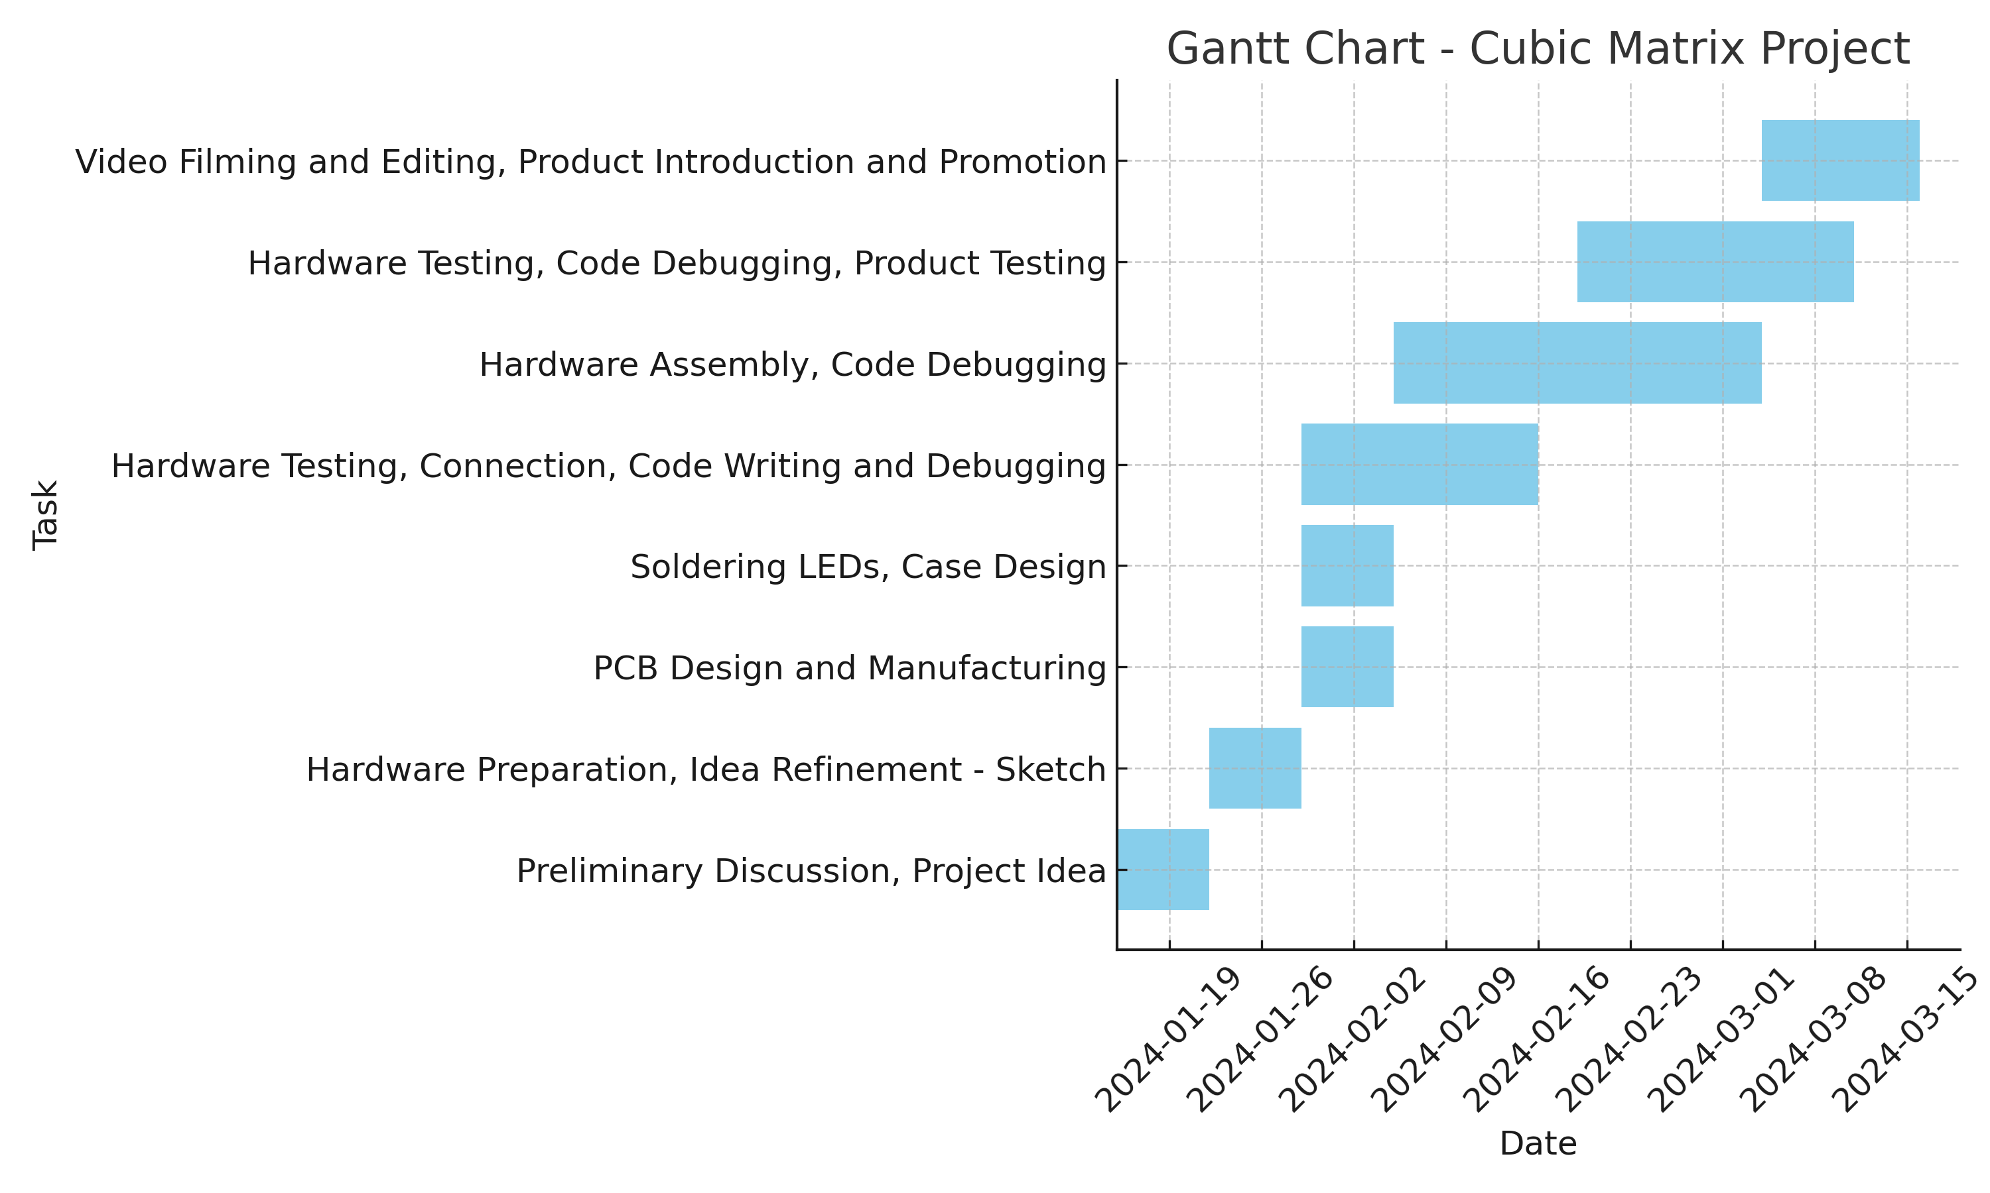
Future Development Plans
Next Steps for the Project

Slide 18
Reference
[1] https://www.hse.gov.uk/temperature/thermal/
[2] https://www.ucl.ac.uk/bartlett/energy/news/2018/dec/study-mitigating-effects-higher-co2-levels-productivity-receives-widespread-coverage
[3] https://www.cibsejournal.com/cpd/modules/2020-05-swegon/
[4] Vadodaria, K., 2014. Thermal comfort in UK Homes: how suitable is the PMV approach as a prediction tool? (Doctoral dissertation, Loughborough University).
[5] Makeability Lab. (n.d.). L6: RGB LEDs - Physical Computing. Retrieved January 21, 2024, from https://makeabilitylab.github.io/physcomp/arduino/rgb-led.html

